Slide 1
SG Technologies
Inception Phase
Nicholas Gennuso
Rafael de Oliveira
Jianing He
Jeremy Ying
Chang Sun
Matt Raporte

Slide 2

Business Problem Statement
The problem of | poorly structured and functioning POS systems
affects | Retail Stores and the managers, cashiers and customers that interact with these systems.
the impact of which is | Retail inefficiency through wasted time and dissatisfied staff/customers
a successful solution would be | a simple to use, computer application that will allow the Retail location to handle/record sales, rentals and returns as well as including useful service applications and features such as fault-tolerance and administrative functionality.

Slide 3
Product Position Statement
For | Retail Stores
Who | Need software to handle customer transactions and log data
The POS System | Is a software application
That | Processes/records sales and rentals, also handles returns and refunds.
Unlike | Current POS/other POS systems which aren’t as efficient, easy to use, incorporate useful service applications or have ample fault-tolerance
Our product | Is simple and practical to operate, but filled with useful features.

Slide 4
Vision
Business Opportunity:
The business opportunity met by this project is providing a POS service to those retail business providers need better transaction and management system that is adaptable to their business. By creating a well documented and cleanly structured product we’ll be able to make small changes to adapt to specific customers allowing us to market/sell our product to multiple customers at once. By incorporating features such as an emergency off-line mode, administrative inventory control and well-structured logging we’ll have a final product that perfectly fits our customers’ needs.

Slide 5
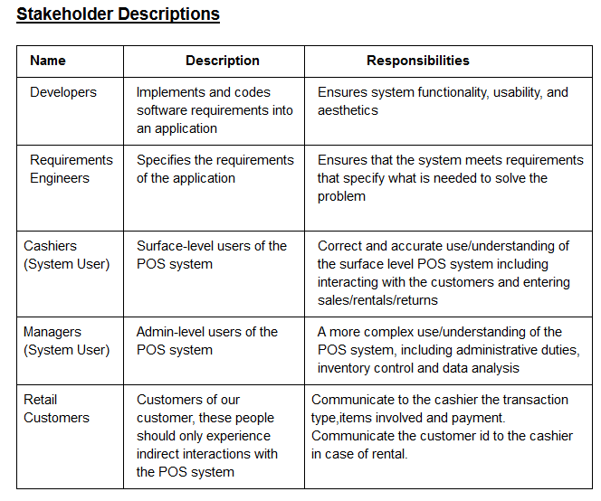
Vision

Slide 6
Vision
Product Overview
SGT POS will be a computerized application used in different retail stores that will record sales and handle payments (process sale), process rentals and handle payments (process rental), and handle returns and refund credit (handle return). The POS will be efficient, elegant and easy to use on surface level (cashiers) as well as administrative level (managers) but also include services such as an off-line mode, a third-party tax calculator and inventory control that will make it top of the line.

Slide 7
Use Cases: Sales (fully dressed)
1. Customer gets to POS checkout with goods and/or services to purchase.
2. Cashier starts a new sale.
3. Cashier enters item identifier.
4. System records sale line item and displays item description, price, and subtotal on the screen. Keeping doing step 3-4 till there is no item left.
5. System displays total price with taxes calculated.
6. Cashier tells Customer the total, and asks for payment.
7. Customer pays and System handles payment.
8. System logs completed sale and sends sale and payment information to the external accounting system (for accounting and commissions) and Inventory system (to update inventory).
9. System presents receipt.
10. Customer leaves with receipt and goods.

Slide 8
Use Cases: Rental (fully dressed)
1. Customer gets to POS checkout with goods/service to rent.
2. Cashier starts a new rental.
3. Cashier enters item identifier.
4. Customer specifies length of time for rental.
5. System records rental line item and time and displays item description, price, and subtotal on the screen. Repeat 3-4 until no item left.
6. System displays total price with taxes calculated.
7. Cashier tells Customer the total, and asks for payment.
8. Customer pays and System handles payment.
9. System logs completed rental and sends inventory, payment, and time information to the external accounting system (for accounting and commissions) and Inventory system (to update inventory).
10. System presents receipt with return date listed.
11. Customer leaves with receipt and goods.

Slide 9
Use Cases:

Slide 10
Use Cases: Process Return
A customer arrives with items to return. The cashier, using the Point of Sale system, records each returned item by their identifier. After all the items have been returned and recorded, the system presents a confirmation receipt to the customer. Customer leaves with the receipt.

Slide 11
Use Cases: User Management
System administrator logs in to the system by user id and password. If there is information about existing users to be modified, system administrator finds the user by entering user id and processes changes. If there are new user profiles to be added, system administrator creates new profile, enters information, and saves the profile. If there is profile to be deleted, system administrator finds the user by entering user id and deletes the profile. After modification, system administrator saves all the changes and logs out of the system.

Slide 12
Supplementary Specs
FURPS+
Functionality
Error handling
all errors occurring log to stable storage
Security
all user information requires user authentication
Usability
Human factors
The text on POS screen should large enough to be seen from 1 meter
The POS system should be easy to use for cashiers
The checkout process should be precise, and quick for customer’s convenience
The management system should clearly list information, and be easy for manager to search and update

Slide 13
Reliability
Recoverability
If one register POS system crashes, other registers can finish the checkout process
If store has a power failure, there is backup electrical system for the store to continue operating
All information stored in the management system has backup on the cloud
Performance
Our goal is to make the checkout process easy and quick to meet customer’s expectation. The only bottleneck we have is that we cannot control the time for requesting credit authorization, but we would try to make it responds under 30 seconds.
Supportability
Adaptability: when process sale with different customers, it should be able to plug new business rules under customer’s requirements. The system can be easily updated without rework other parts of the system.
Configurability: The system needs to be configurable and flexible for its business and performance needs.

Slide 14
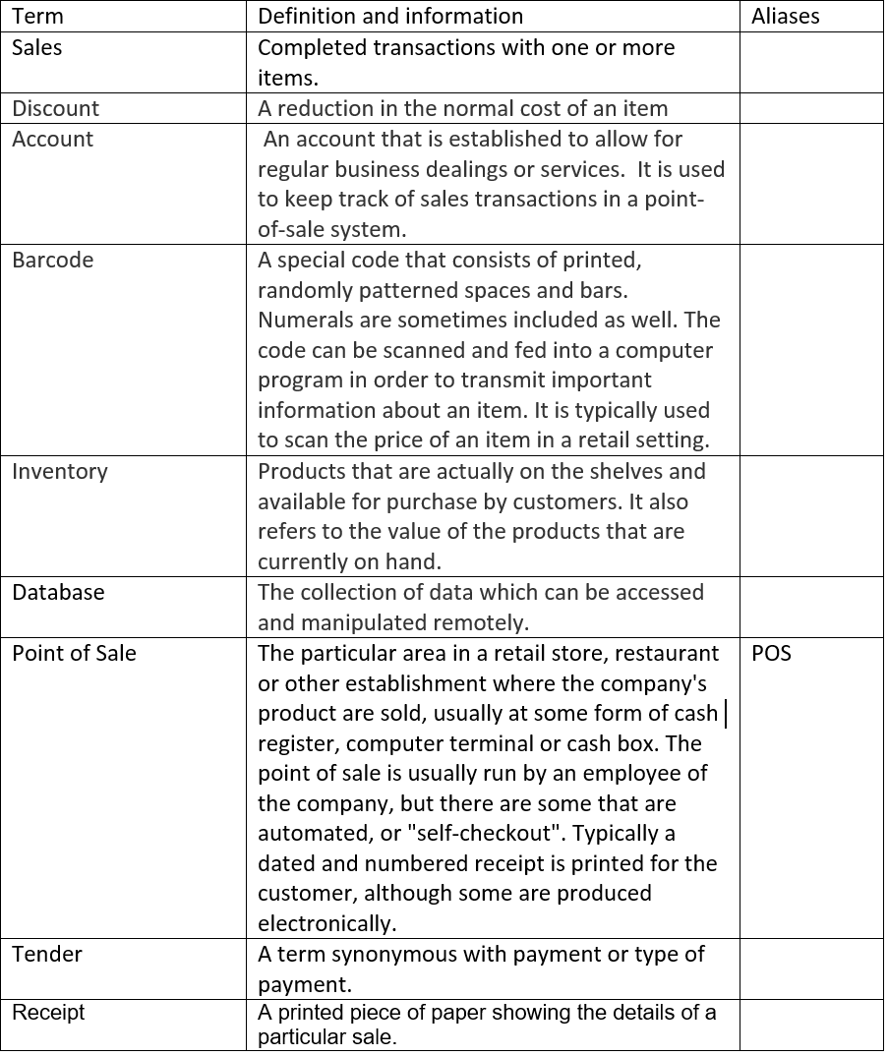
Glossary

Slide 15
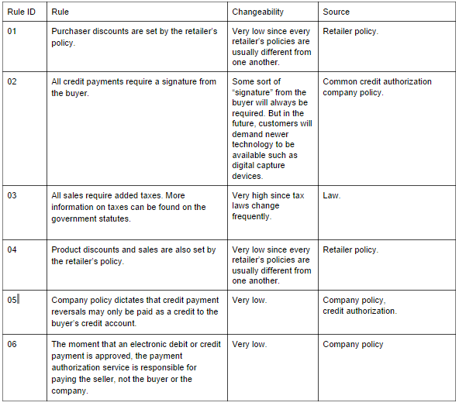
Business Rules

Slide 16
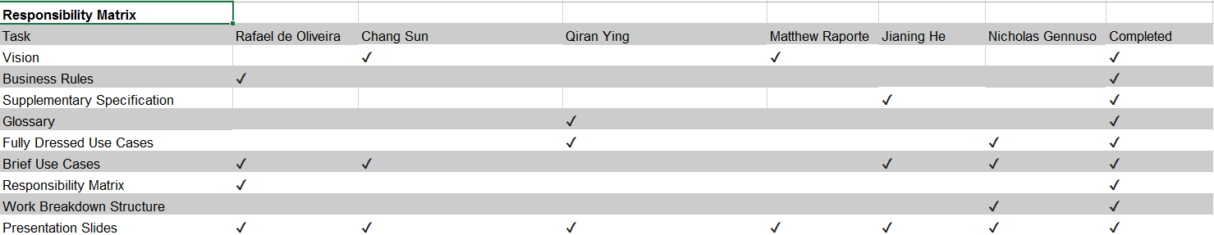
Responsibility Matrix

